Slide 1
Model Feasibility Assessment
Predicting the success or failure of ML training runs from hyperparameters
Team: Vaibhav - 25WU0102209
Himesh Sarvan - 25WU0102099
Srinidhi Yatharla - 25WU0102309
Akshaya Reddy – 25WU0102304
Nikhilesh Chandra – 25WU0102206
Program: AI & ML Mentor: Dr. Roopa Batch: 2025 - 2029
Final Evaluation : 06 – 10 – 2026

Slide 2
Agenda
01
Problem Statement
05
Testing & Validation
02
Literature Review
06
Innovation & Future Scope
03
Methodology
07
Conclusion
04
Implementation

Slide 3
01
Problem Statement
CONTEXT
PROBLEM
OBJECTIVE
Training ML models costs time and compute. Poor hyperparameter choices are a common cause of wasted runs.
Failures are often found only after hours of training. Some are loud (NaN loss), others silent (model trains but never learns).
Predict success probability and likely failure mode before training, from the planned hyperparameters.

Slide 4
02
Literature Review
EXISTING WORK
GAP
  AutoML tools (Google Vizier, Optuna, Ray Tune) search for the best hyperparameter configuration among many candidates.
  Research shows learning rate and batch size are the most common causes of training divergence (Smith, 2017; Bergstra & Bengio, 2012).
Existing guidance is scattered rules of thumb, with no quick tool to check a planned run.
OUR APPROACH
One form that returns a probability, a failure mode and reasons.

Slide 5
03
Methodology
1
Data collection
5
LLM explanation layer
Log hyperparameters and outcomes
Plain-language reasoning
2
Feature engineering
6
UI
Encode and engineer risk features
User inputs config, gets result
3
Train meta-classifier
7
Integration and demo
Random forest or XGBoost
End-to-end testing
4
Evaluation
Recall, precision, ROC-AUC
TECH STACK
Python, FastAPI, scikit-learn, joblib, SQLite, HTML/JS

Slide 6
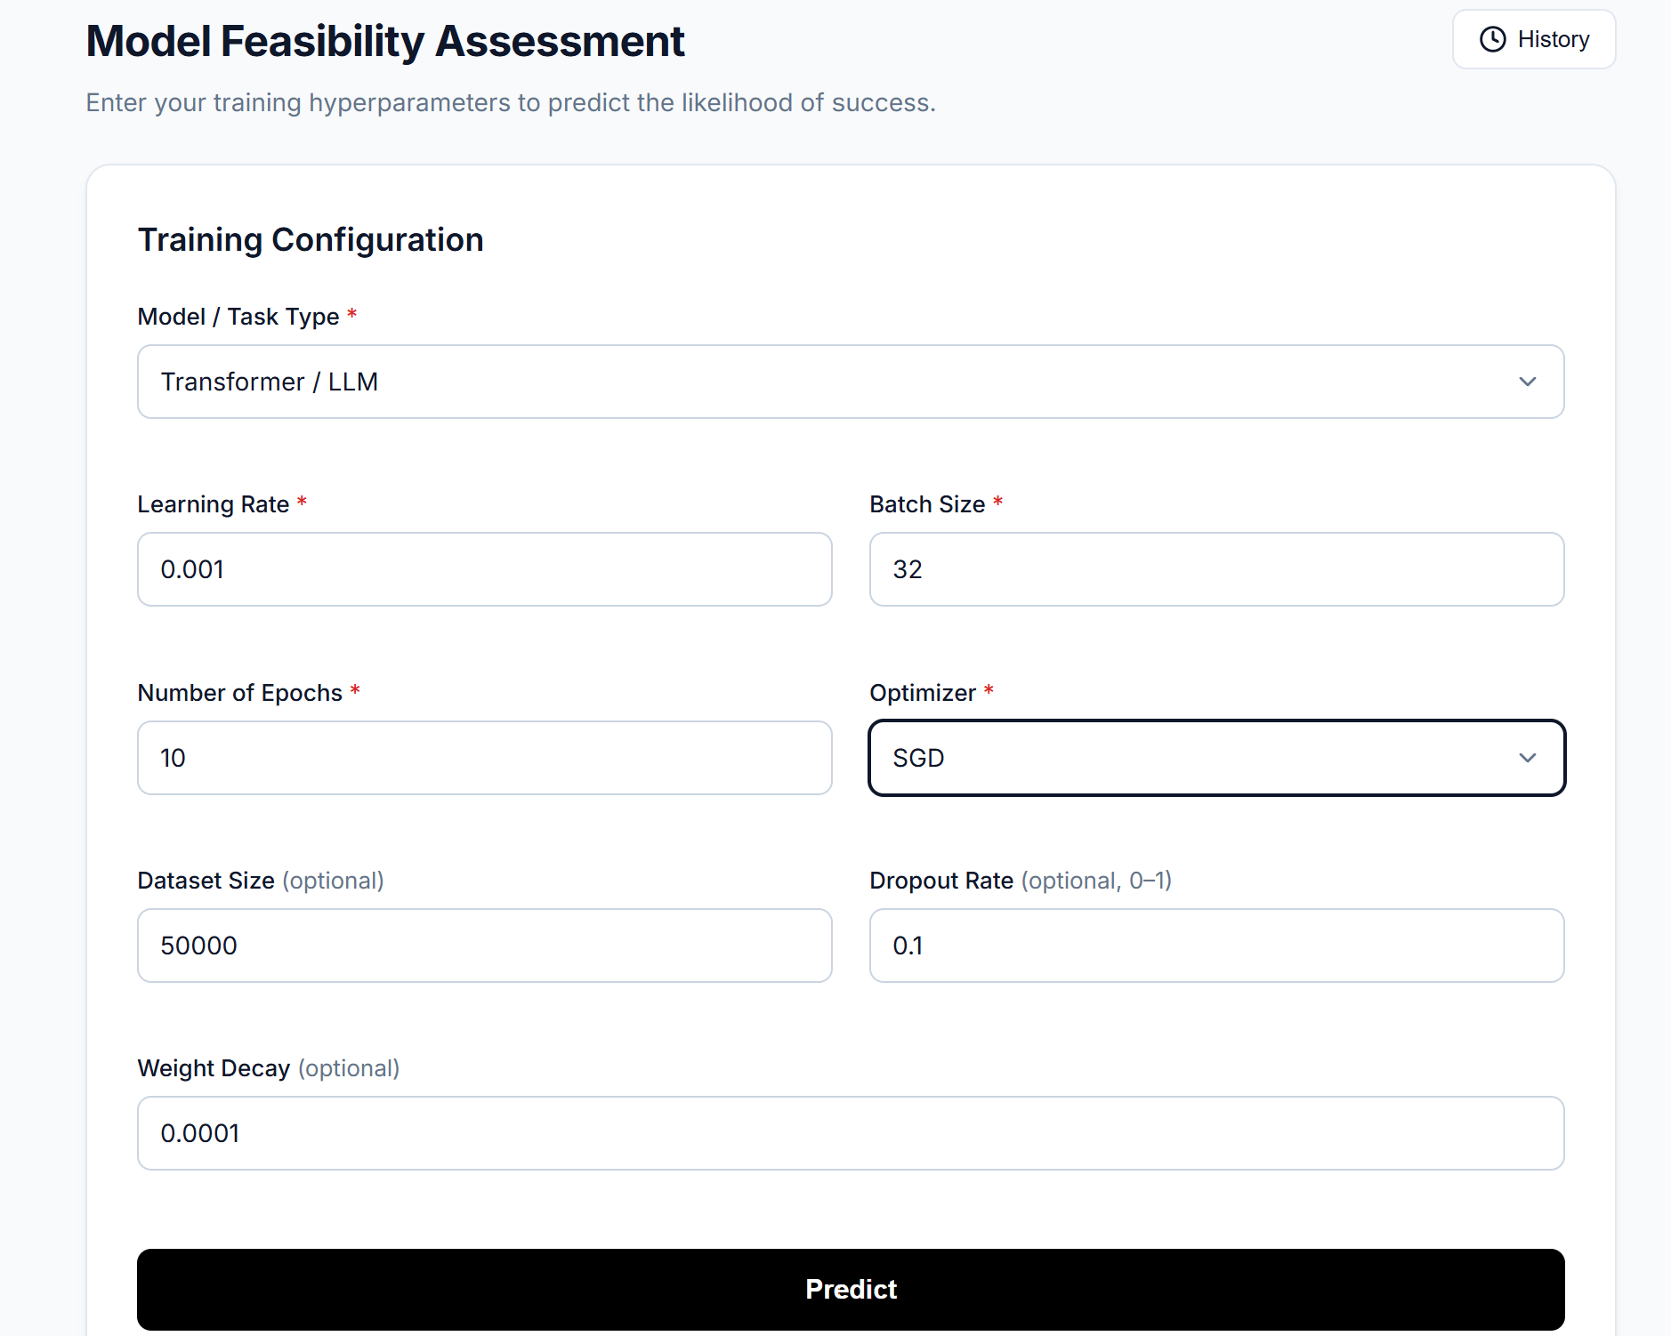
04
Implementation
KEY FEATURES
Hyperparameter input form
Success probability and failure mode
Plain-language risk explanations
Saved assessment history
Input validation
GitHub: https://github.com/srinidhiyatharla-png/Model-Feasibility-Assessment-system-
Live demo: file:///C:/Users/SRINIDHI%20YATHARLA/Downloads/model-feasibility-assessment/model-feasibility-assessment/index.html

Slide 7
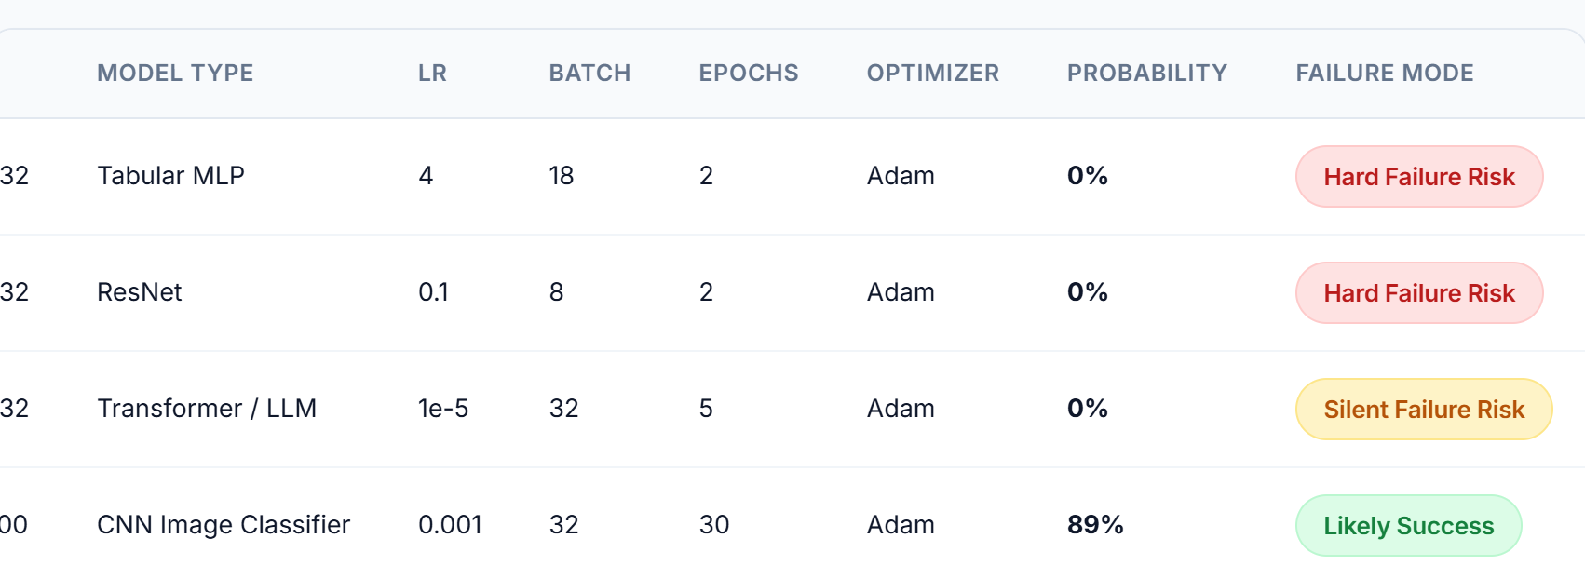
05
Testing & Validation
[ XX% ]
4/4
[ XX ms ]
Model accuracy
Sanity tests passed
Avg response time
Test input | Expected | Result
LR 0.001, batch 32, 30 epochs | Likely Success | Passed (89%)
LR 0.00001, batch 32, 5 epochs | Silent Failure Risk | Passed
LR 0.1, batch 8, 2 epochs | Hard Failure Risk | Passed
LR 4, batch 18, 2 epochs | Hard Failure Risk | Passed (0%)
Results from the app history

Slide 8
06
Innovation & Future Scope
WHAT MAKES THIS UNIQUE
FUTURE SCOPE
Predicts the failure type, not just pass/fail
Catches silent failures, not only crashes
Explains why a run is risky
Instant result before any compute is spent
Train on real experiment logs
More model types and optimizers
Suggest better hyperparameters
Cloud deployment and team accounts

Slide 9
07
Conclusion
SUMMARY
KEY LEARNINGS
We built a web app that predicts whether a planned training run will succeed or fail, shows the likely failure mode and explains the risks. The prototype uses synthetic, rule-derived data.
Hyperparameter behaviour and failure modes
Building and serving an ML model with an API
Teamwork with Git and GitHub

